Slide 1

Digital Strategy
MGT 857 Fall 2023
Session 11
(Blockchain)
Vineet Kumar
Yale School of Management

Slide 2
Today’s Agenda
Technology of Blockchain
Understanding the technical details helps separate true capabilities from the hype
Helps evaluate feasibility, appropriateness
Hash Functions
How a Blockchain works
Smart Contracts

Slide 3
Introduction to Blockchain

Slide 4
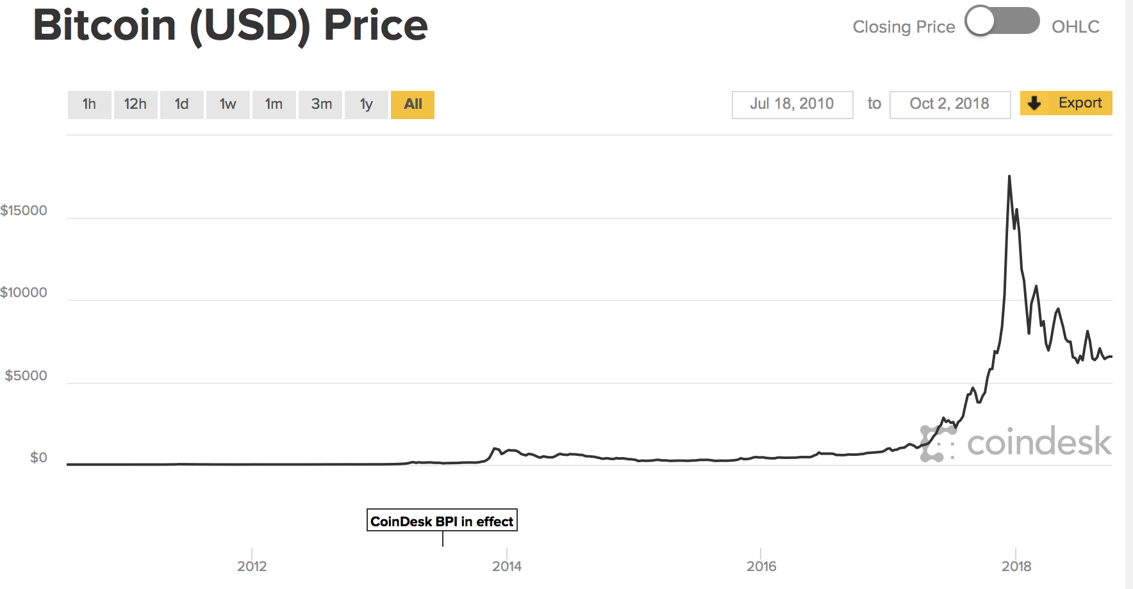
Blockchain versus Bitcoin?
Even if price of Bitcoin (and all other cryptocurrencies) drop to ZERO, Blockchain Technology has value

Slide 5
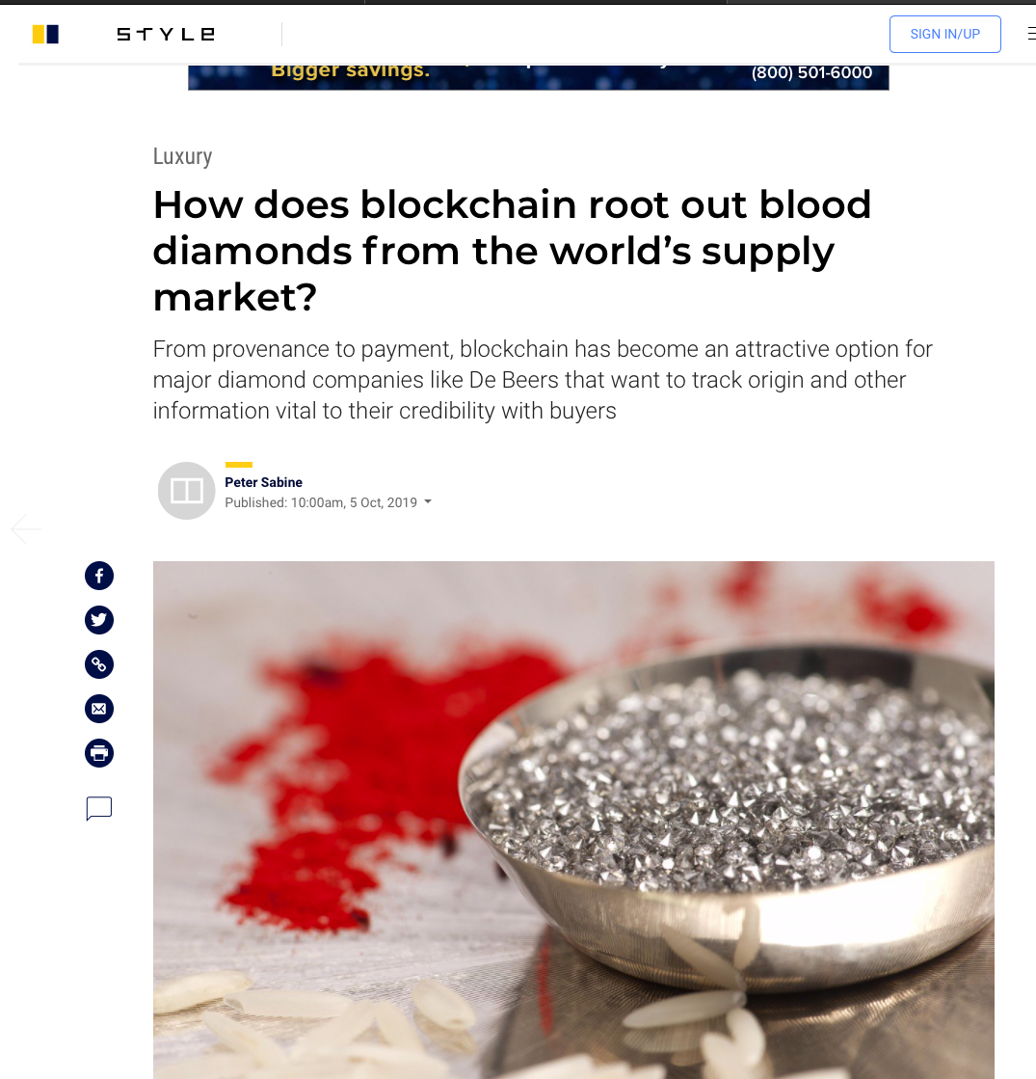
Blockchain Uses
Has a variety of applications in
Supply chain
Retail
Banking
Sustainability
And more…

Slide 6
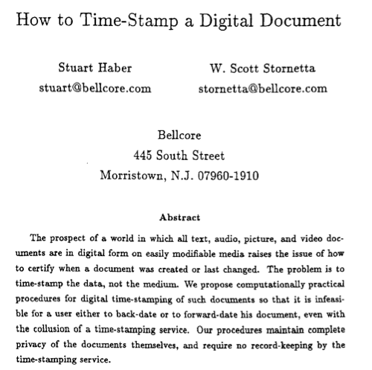
Original Idea
Where did the idea for blockchain come from?
Academic Research had many of the building blocks
Blockchain security is built upon idea of “Hashing”
https://link.springer.com/content/pdf/10.1007/3-540-38424-3_32.pdf

Slide 7
Introduction to Hashing
Hash function (e.g. MD5 or SHA-256) is a function that takes any data (e.g. string) and converts it to:
a number of fixed length
Data*
Fixed-length number
(Binary or Hexadecimal)
Hash Function
*On a computer, all Data (text, audio, video etc.) are stored as Binary Numbers

Slide 8
Where is hashing useful?
Alice wants to send big set of files (message) to Bob
Eve might alter the files
Bob might get fake files
Is there some way for Bob to know if the files are real or altered?
MGT 857 Digital Strategy

Slide 9
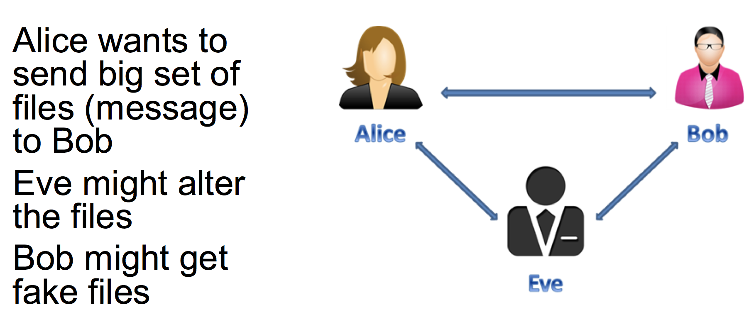
How does Hashing help?
Bob can compute hash of message
Can check with Alice on hash of message using a trusted channel
If Bob’s hash matches Alice’s hash, then messages are same.
Bob needs a way to get the Hash free of Eve’s attack (trusted medium like Eve’s public site)
Or use Public Keys (outside scope of class)
https://www.preveil.com/blog/public-and-private-key/
MGT 857 Digital Strategy

Slide 10
Hash Functions and Passwords
MGT 857 Digital Strategy

Slide 11
Hash Functions and Passwords
Why you might not want to store passwords
MGT 857 Digital Strategy

Slide 12
Passwords and Hash Functions
Problem:
User logs in to website using login and password
Website can store login and password in database
Security issue – what if hacker obtains database?
Hash-based Solution:
Store hash of password
When user logs in:
compute the hash of password entered by user
compare this hash with stored hash
if they match, permit the user
https://auth0.com/blog/hashing-passwords-one-way-road-to-security/

Slide 13
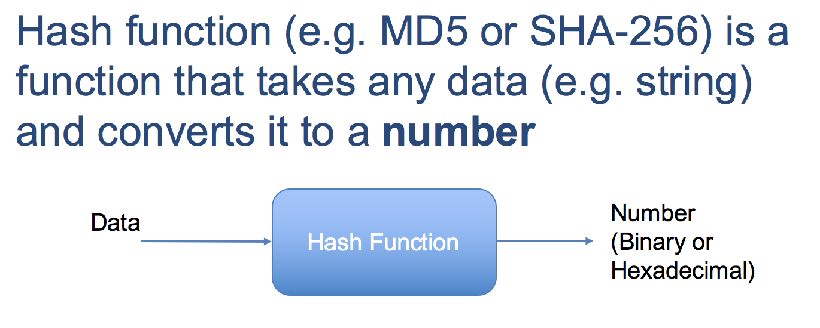
Hashing
Potential Hash functions:
Odd or even?
Length of message
Take the first character, convert to number
Sum or Product of substitution ciphers
Substitution Cipher:
A=01,B=02,..Z=26
http://rumkin.com/tools/cipher/numbers.php

Slide 14
Hashing Example
https://passwordsgenerator.net/sha1-hash-generator/
https://hash-generator.io/online-sha1-hash-generator.php?hl=en

Slide 15
Properties of Ideal Hash Function
A good hash function satisfies these:
All messages generate same length hash
e.g. SHA-256 is 256 bits (or 64 Hexadecimal)
Deterministic
One way function (also called Pre-image resistance)
Cannot go from pre-specified hash output to message
Tamper Resistance (or Second-preimage resistance)
Given a message cannot find another message that has same hash output as this message
Collision Resistance
Cannot find ANY two messages that have same hash output
Notes:
(a) By “Cannot,” we mean it is computationally very, very difficult.
(b) Property (3) $⟹$ (4), but not the reverse.
(c) We have seen some “attacks” on SHA, where people try to break the security.
https://techcrunch.com/2017/02/23/security-researchers-announce-first-practical-sha-1-collision-attack/
(d) You can try out this SHA-256 Hash Generator
http://passwordsgenerator.net/sha256-hash-generator/
Lots of SHA generators available online.
Algorithm is well-known, not a secret, but somewhat complex. In fact there is a US government standard by NIST detailing the algorithm:
https://csrc.nist.gov/csrc/media/publications/fips/180/4/final/documents/fips180-4-draft-aug2014.pdf

Slide 16
Questions about Hashing
Is Hash the same as Encryption? Or Compression?
No, cannot go back from hash to message
With encryption or compression original is recoverable
How do password hashes work?
Store only hash of password
Where else is SHA hashing used?
It is used in SSL certificates in your browser

Slide 17
What is (a) Blockchain? How does it work?

Slide 18
Is a Blockchain a Database?
Source: https://www.chicagofed.org/publications/economic-perspectives/2017/7

Slide 19
Building a Blockchain
Hash of Prior Block
SHA-256 Hash of Block 1
SHA-256 Hash of Block 2
SHA-256 Hash of Block 3
$$A→B:50$$
C$→D:10$
$$D→B:4$$
$$B→D:100$$
$$M→B:50$$
$$D→A:10$$
$$D→B:4$$
$$M→D:24$$
$$F→B:200$$
$$C→E:9$$
$$A→D:17$$
Data
Block 2
Block 4
Block 3

Slide 20
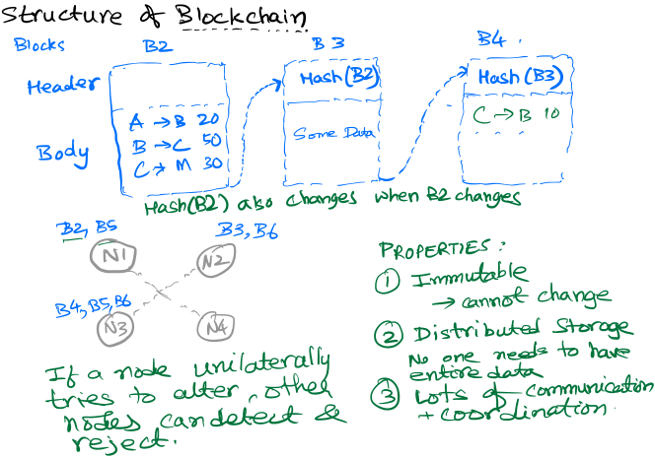

Slide 21
Properties of Blockchain
Immutability (most important)
Recorded transactions cannot be changed by anyone
Provides a complete audit trail
Distributed Storage of Data
No central node needed
No centralized trust required
(*) Ledger is publicly visible
for Public Blockchains but not Permissioned / Private ones

Slide 22
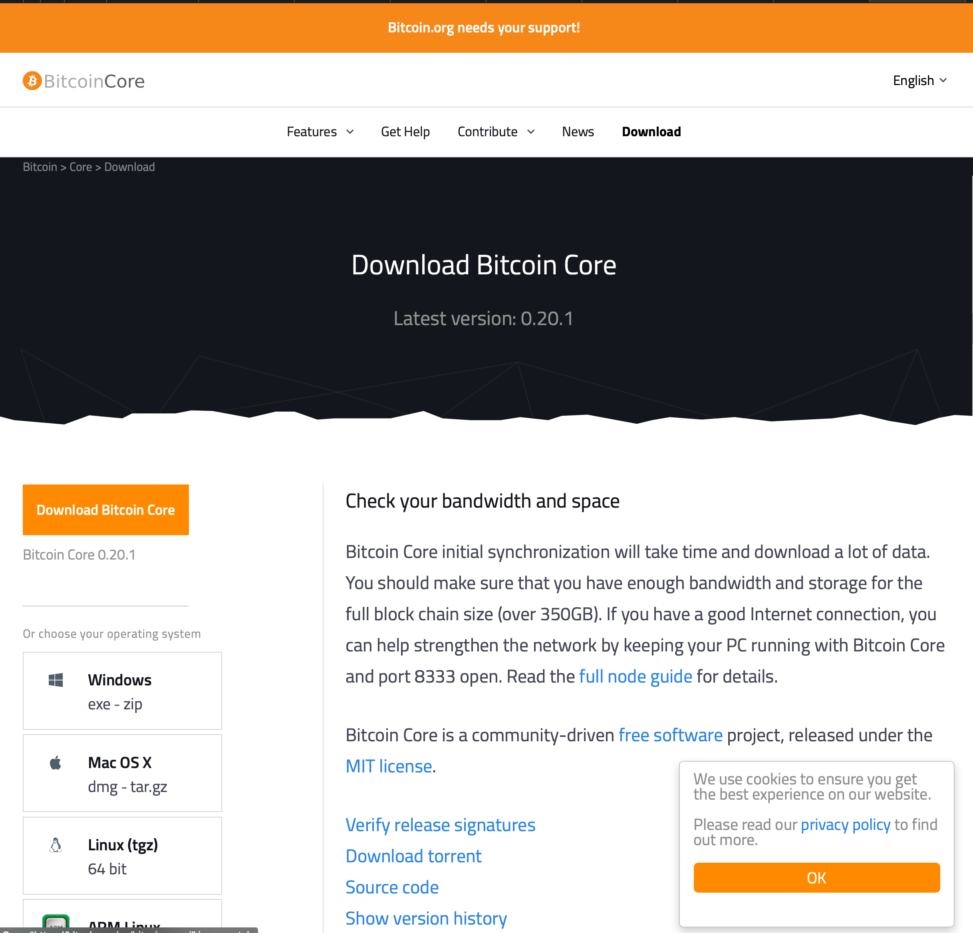
https://bitcoin.org/en/download
MGT 857 Digital Strategy

Slide 23
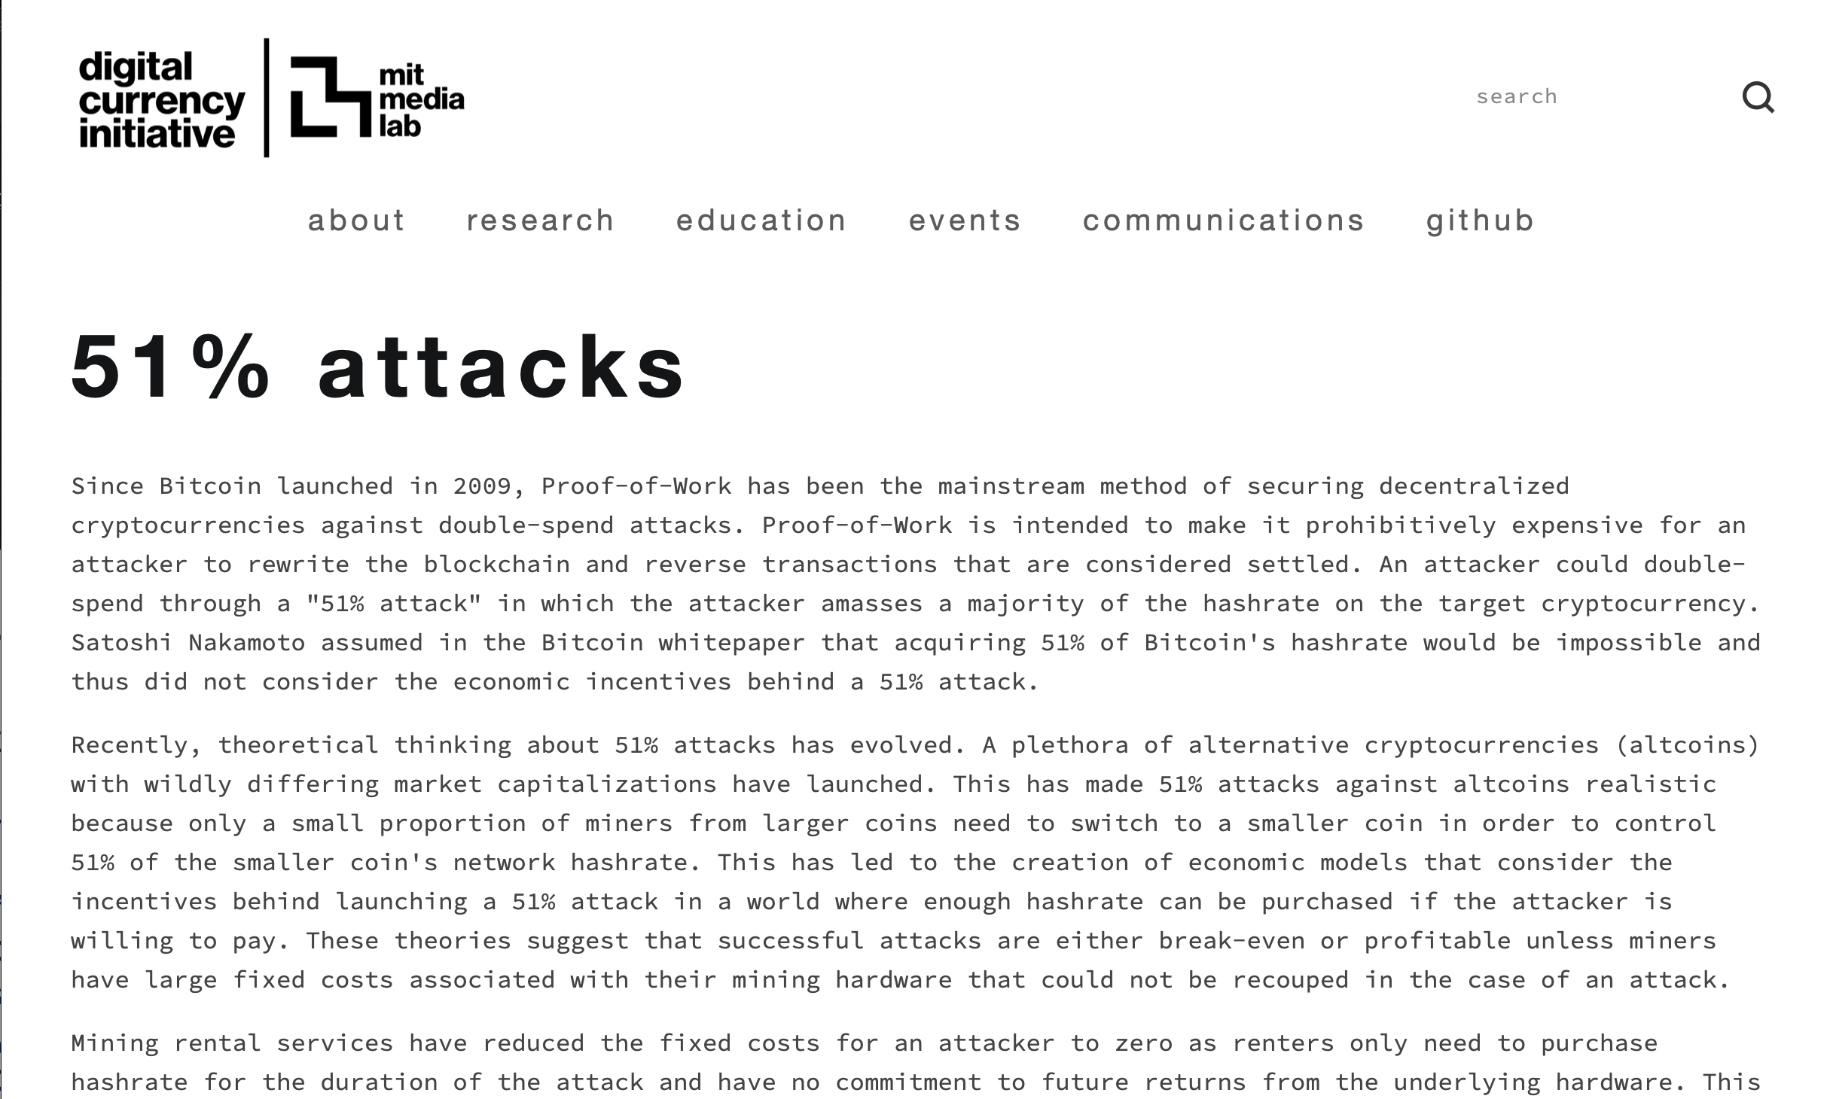
https://dci.mit.edu/51-attacks

Slide 24
Blockchains versus Cryptocurrencies NOT the same
What we described previously was for a general blockchain
Cryptocurrencies require much more
Security and Identity so both sender and receiver can be ascertained by Public Key Cryptography
Interesting stuff but details are beyond scope of this course
Proof of Work:
algorithm rewards miners who solve mathematical problems
Random process with very low probability so requires miner to search through a huge space (needle in haystack)
A node has no guarantee it will be able to find solution
Crucial: Verifying it is quite easy
https://blog.wetrust.io/why-do-i-need-a-public-and-private-key-on-the-blockchain-c2ea74a69e76

Slide 25
Where is Blockchain most useful?
In situations where we have:
Lack of Trust between counterparties
Relationship between many different entities
Long supply chains
Networks
Lots of intermediaries
Limited volume of transactions
1000s of transactions per second

Slide 26
When should you NOT use Blockchain?
Data is mostly used within organization
Yale’s Student Records
Bank Account Records
Security is not very important
Data is continuously changing and historical data has no value
Huge volume of transactions
credit card networks have 3000+ transactions per second
All nodes need to very each transaction in Blockchain
Need legal certainty (currently a developing area of law)

Slide 27
Public versus Private Blockchains
By default, public blockchains allow *anyone* to see all transactions
Private or Permissioned Blockchains allow only verified users (Public Key)
Example: Coffee producer wants to store verification of fair trade on permissioned blockchain
Make data available to all customers / suppliers but not competitors

Slide 28
Conditional Code Execution
If This Then That
https://ifttt.com/
How can we extend this to contractual arrangements?
Ethereum

Slide 29
Smart Contracts
Conditional Code Execution extended to contracts
Allows individuals to trade with strangers with no trust or centralization required.
If condition X is satisfied, then make a payment transfer from A to B.
Ethereum, Codius, Counterparty are designed for smart contracts

Slide 30
Simple Smart Contract
Ann and Bo bet on the weather
If it does NOT snow before Nov 30, Ann wins $100
Otherwise Bo wins $100
Might need access to trusted source of data to verify that condition X is satisfied
Sources agreed in advance by parties
Smart Contract embeds this code in a blockchain.

Slide 31
What are the benefits of Smart Contracts?
Avoid intermediaries
Speed – A contract can be set up by two parties in just a few minutes
Happens automatically with self-executing code => little execution risk
Minimize manual human error in interpretation

Slide 32
Small Group Exercise
Form small groups.
Discuss an application for Smart Contracts
Identify all the entities that need to be part of contract
Indicate who trusts (and does not trust) whom
What benefit does smart contract provide over a traditional contract?
Discuss with group for about X minutes
We’ll discuss this together with the entire class

Slide 33
Are these smart contracts?
If the temperature exceeds 80 F, then turn on the AC
Seller says: “If you pay me $100, I will ship this by end of November”
A pays B $100
If the temperature today exceeds 80 F in New Haven, then A pays B $100 today

Slide 34
Smart Contracts
If loan is not paid back, then car does not start
Car can be set up to check every month or even when each trip begins
Needs the following parties to work together to develop contracts: manufacturer, lender, customer among others
Has potential to avoid costly intermediaries
Raises Legal and Ethical Issues
What if you are sick and need to go to a hospital?

Slide 35
Blockchain Summary
Can generate “trust” even when no one trusts anyone else
You don’t need to know the other person for both to trust cash
Built on strong mathematical foundation but security still subject to attacks
Main advantage is ”Immutability” – lots of other advantages follow from this property
Big disadvantage is the time it takes to confirm transactions
Smart contracts have a lot of potential to simplify and expand the range of contract possibilities

